Slide 1
Peebles High School Parent Experience Survey

Slide 2
Aim of the survey
Parental experience at PHS over time
Completed in 2022 and 2023 – plan to run the survey annually
Questions relating to:
Additional Support Needs (ASN)
Communications
Support
Coverage of Curriculum
Tutoring

Slide 3
Results 2023 ( and how this compares with last year)

Slide 4
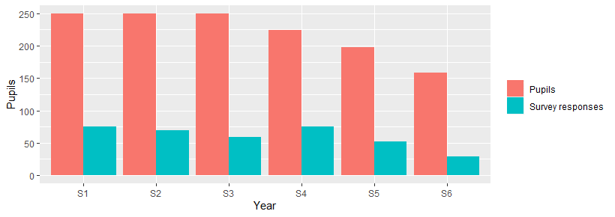
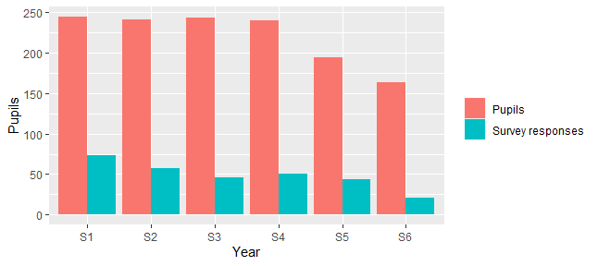
Which year is your child(ren) in?
265 responses representing 359 pupils (27% school roll)
2022
219 responses representing 291 pupils (22% school roll)
2023

Slide 5
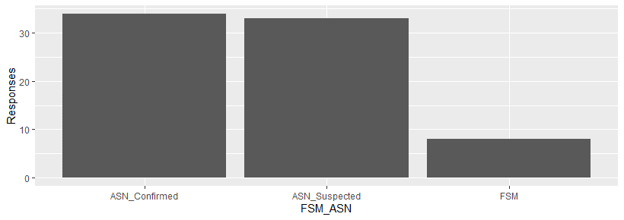
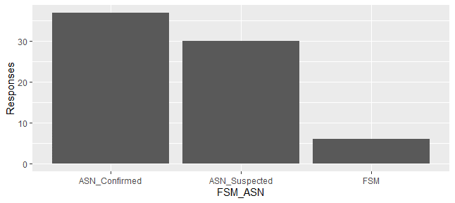
Responses representing parents of pupils eligible for free school meals (FSM) or with additional support needs (ASN)
2022
2023

Slide 6
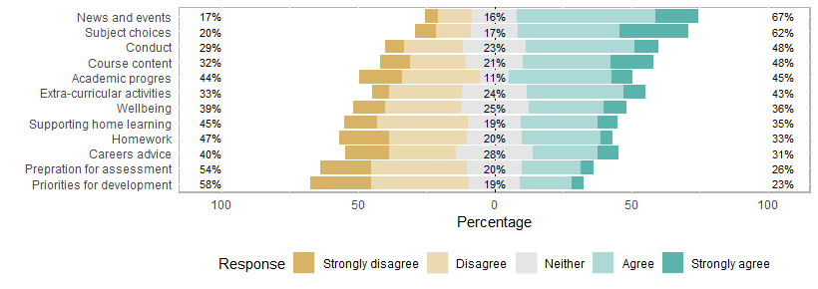
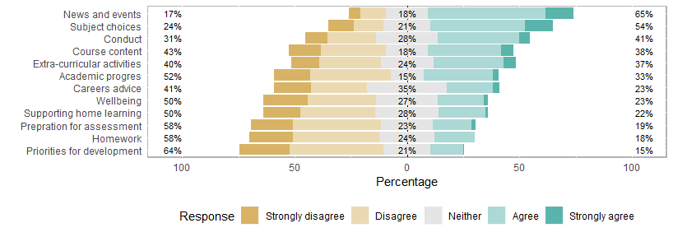
I am satisfied with the communications I receive from PHS
2022
2023

Slide 7
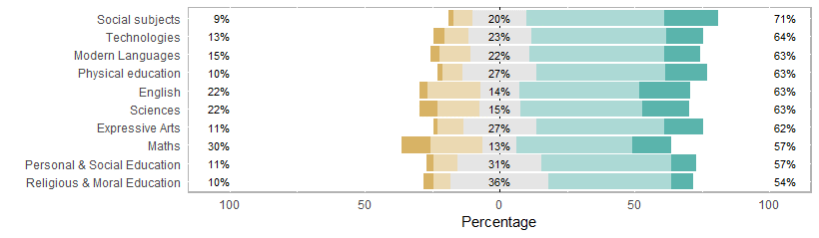
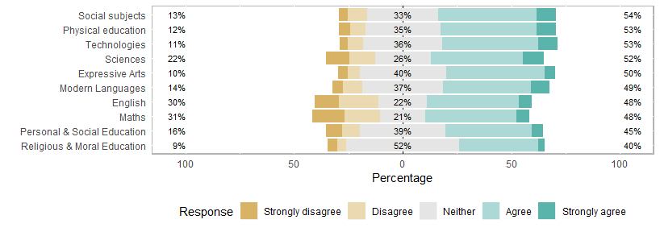
My child is covering the course content in sufficient depth and at an appropriate speed
2022
2023

Slide 8
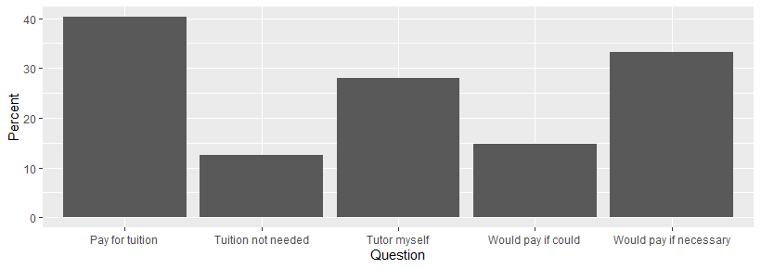
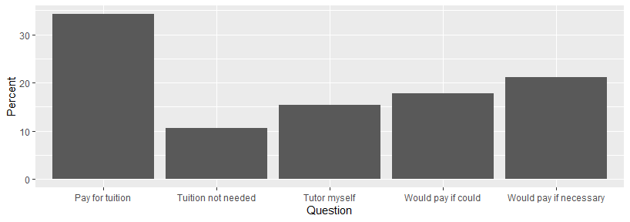
Use of tutors (percent of responses)
2022
2023

Slide 9
Use of tutors (percent of responses)
2022
*
*
* 67%
*
2023

Slide 10
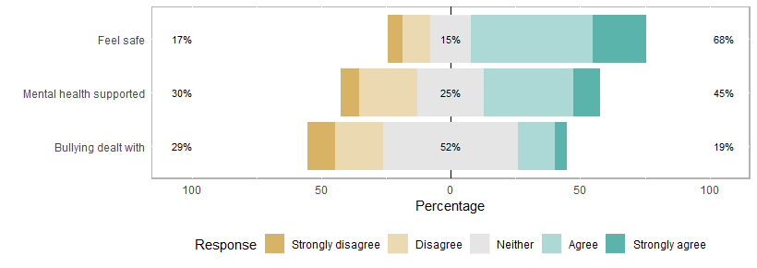
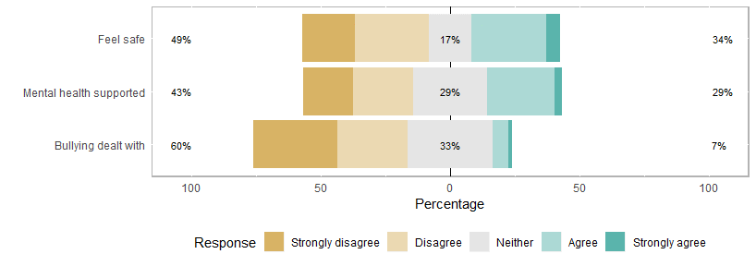
Questions about support
2022
2023

Slide 11
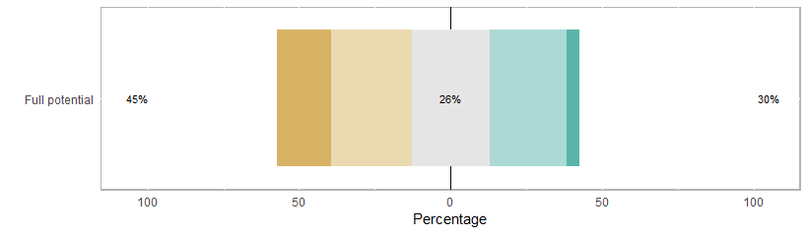
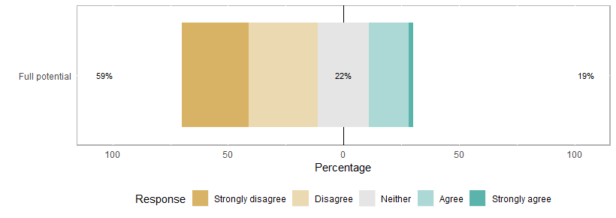
I believe that PHS facilitates my child(ren) to reach their full potential
2022
2023

Slide 12
Key messages
Communications around individual learners continues to be of most concern to parents (e.g. homework, development priorities, assessment preparation)
Maths continues to be the subject scored most poorly in terms of moving at the right pace and depth - English also has a poorer score than last year
67% of responses had a tutor, tutored by parent or would pay if could
‘Mental health supported’, ‘Feeling safe’ and ‘Bullying dealt with’ have declined considerably since last year - only 7% agreed that bullying was dealt with appropriately
Only 19% feel that their child’s potential will be reached at PHS

Slide 13
Focus on ASN for 2023 only

Slide 14
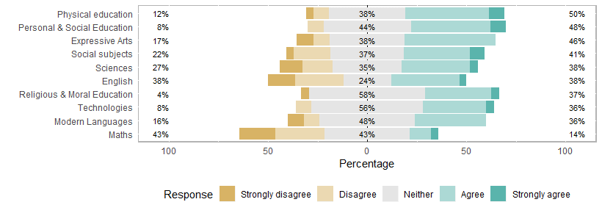
Responses for pupils with ASN
2023 All responses (n=291)
My child is covering the course content in sufficient depth and at an appropriate speed
2023 ASN responses (n=37)

Slide 15
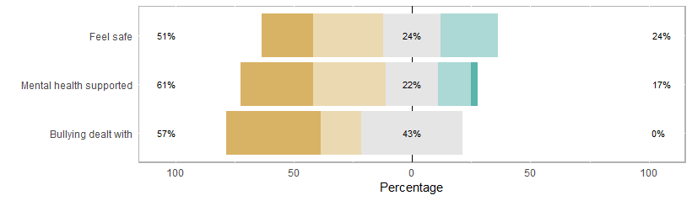
Responses for pupils with ASN
2023 All responses (n=291)
2023 ASN responses (n=37)

Slide 16
Key messages
Parents of pupils with ASN showed a reduction in agreement that course content is covered in sufficient depth and at an appropriate speed
Particularly in Maths, English and Social Subjects
Parents of pupils with ASN showed a reduced agreement relating to ‘Mental health supported’, ‘Feeling Safe’ and ‘Bullying Dealt with’
No parents of pupils with ASN agreed that Bullying was Dealt with appropriately

Slide 17
What next?
Results have been shared with the School
Open text comments will be reviewed and shared with the School
These views will be included in discussions with school when developing the School Improvement Plan for next academic year
Continue to collect annual survey responses to ensure parental voice is heard

