Slide 1
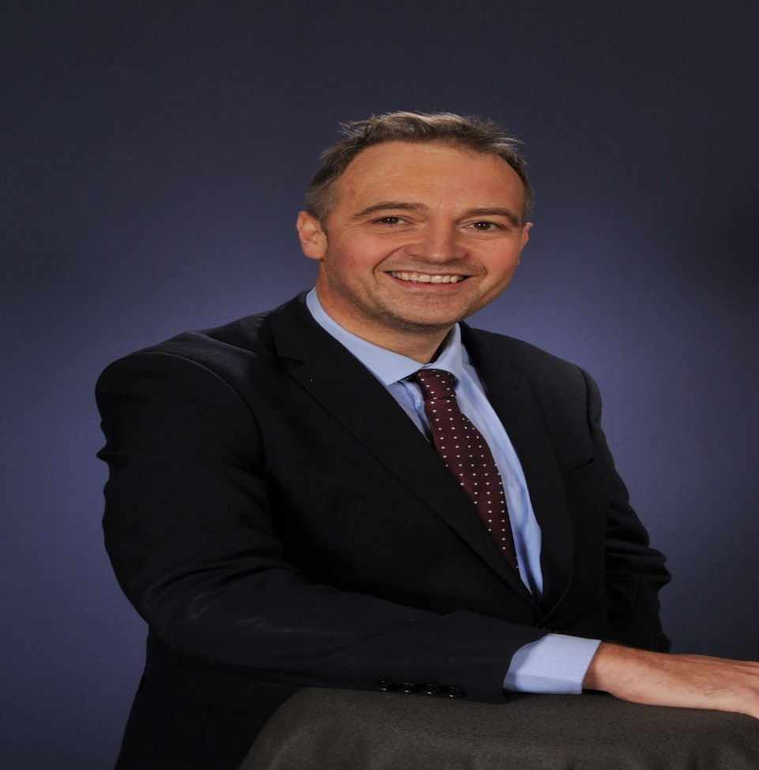
Welcome to Peebles High School
We are very excited to meet you!
10/02/2021

Slide 2
How good is your new School?
Excellent record of helping young people get the most out of their learning
Our values and what we stand for
The broad range of clubs, trips, activities and other extra curricular activities
Our relationship with our parents
Transition 2021 plans
Update on our facilities
The attitude to overcome challenges and achieve excellence
10/02/2021

Slide 3
Our record of improving results for young people over time
In 2011/12 : 20% of 16/17 year olds sitting their examinations in S5 attained 5 Highers in their S5
After a sustained improvement over the last decade, this has doubled to 40% of our S5 and, importantly, over 50% of young people who stay with us to S6 achieve this standard by the time they leave us.
More importantly, the percentage of all leavers moving on to a sustained positive destination has risen to 98% over the same time frame.
27/01/2021

Slide 4
Our Values
Compassion
Wisdom
Integrity
Justice
Headteacher lessons introduced this year
27/01/2021

Slide 5
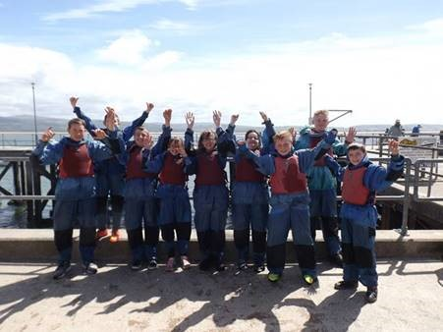
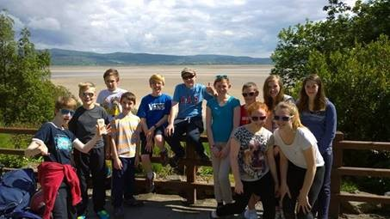
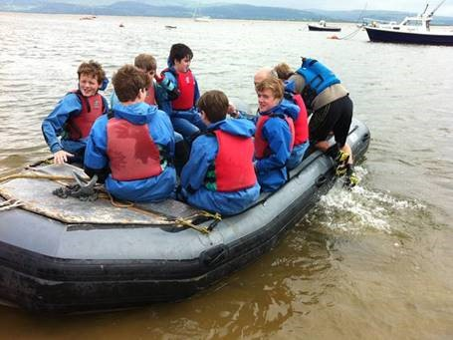
S1Residential:
27/01/2021

Slide 6
Music and Sport and so much more!
May 2019

Slide 7
Welcome P7 Families! PHS Parent Council “Partners and Advocacy”

Slide 8
The role of the PC is to :
Identify and represent the views of parents in matters relating to the education of our children
Work actively in partnership :
With the school, its pupils, parents and the local community to help every
pupil maximise their potential.
2) With National and Regional authorities
Develop and engages itself in activities that support the school in relation to the education and welfare of the pupils, including influencing the design and implementation of the School Improvement Plan.
Lobby and advocate for the needs of parents and pupils at all levels
Engages in fundraising activities to provide additional facilities and resources for the school.

Slide 9
Planning Cycle
National
Planning
PCPPPC
PC Plans
SBC Level
School
Planning

Slide 10
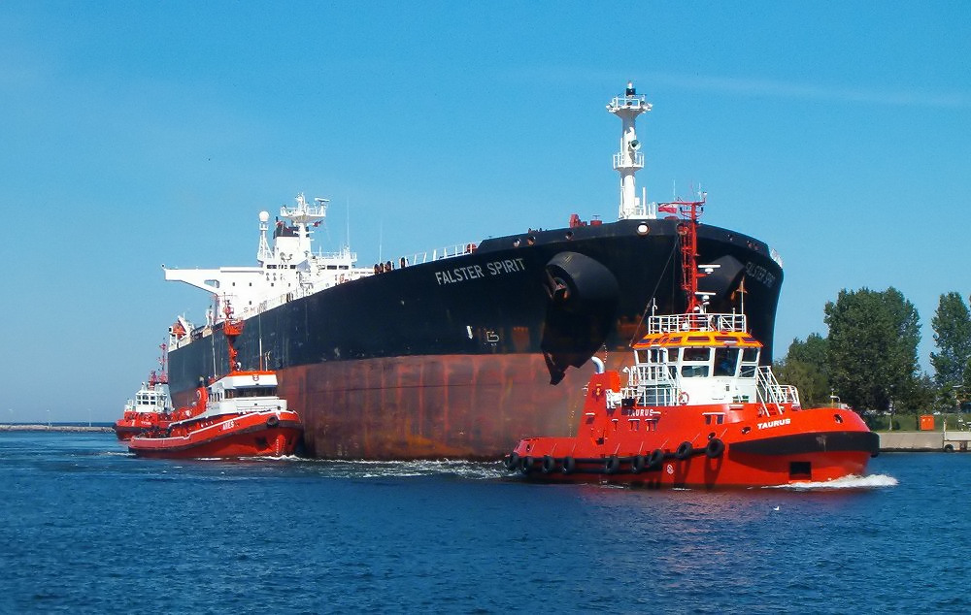
What is our role with school – our vision?
Or

