Slide 1




AGENDA
Parent Council
  Welcome
  Support for Learning and Neurodiversity
  Pupil support
  Learning and Teaching update
  Open Forum S2
  Headteacher update & Q&A
We are waiting a few minutes to get a chance for everybody to join
Please put yourself on mute
If you struggle with quality at your end, consider turning your camera off
To ask a question / contribute, please
  Raise your hand - you'll be invited to unmute & speak
  Use the chat function
In rare cases, the 2 options above are not available, in which case please drop an email to phspc@outlook.com with your question

Slide 2

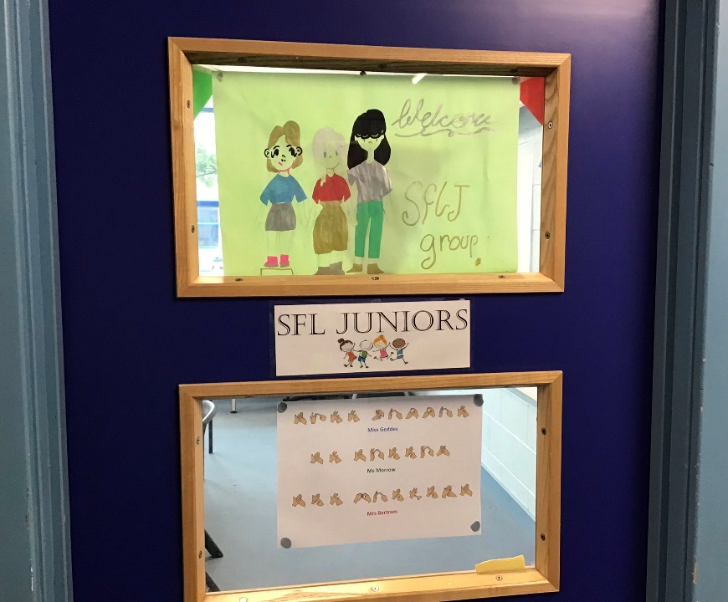
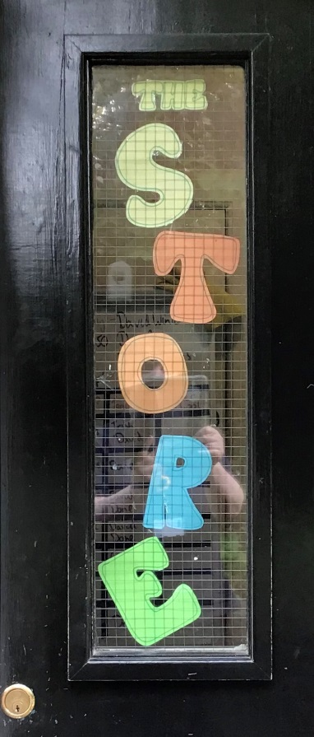
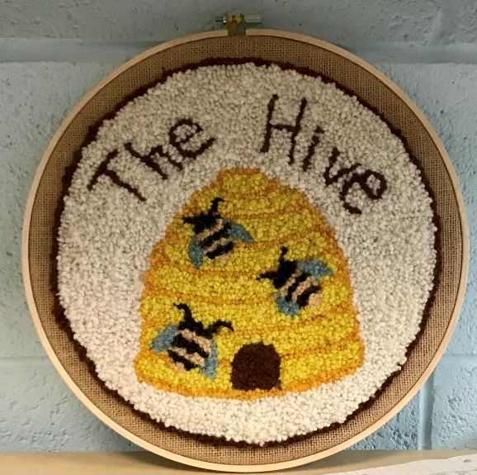
Support for Learning (SfL)

Slide 3
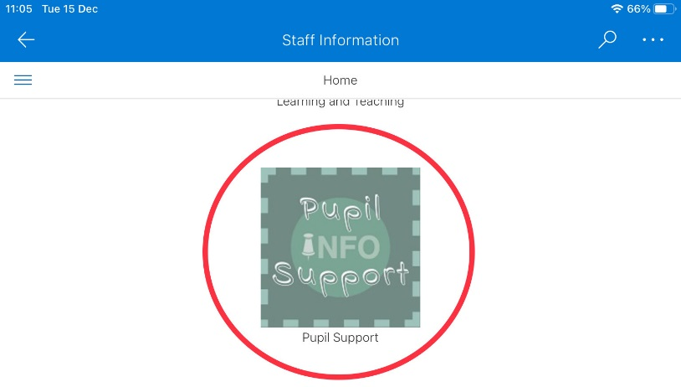

Information for Staff

Slide 4
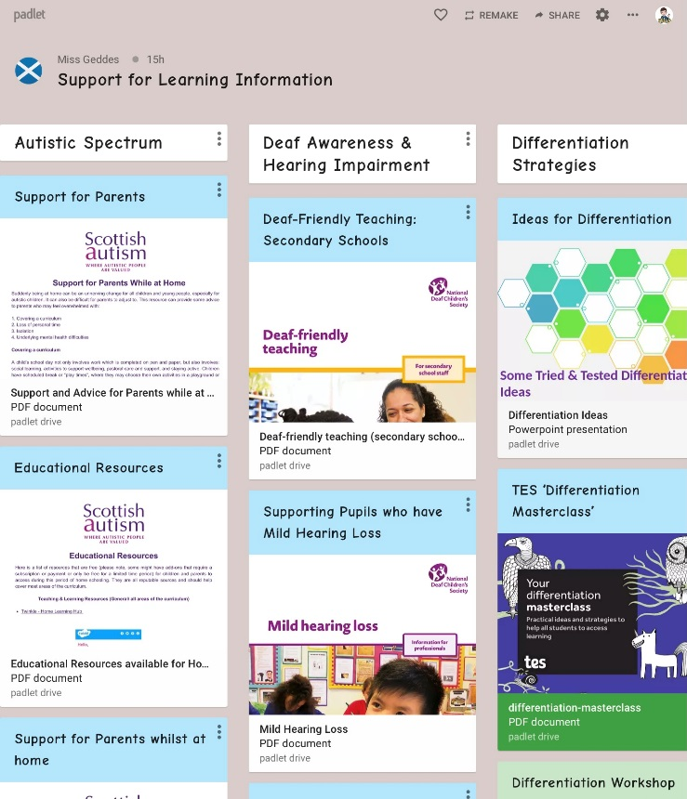
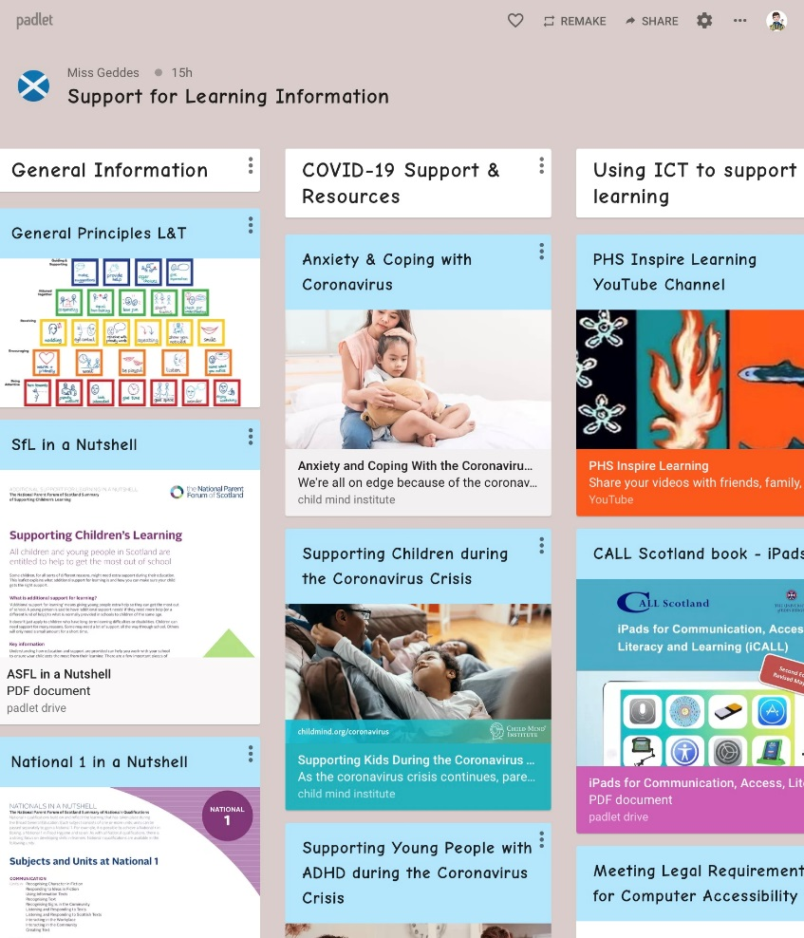
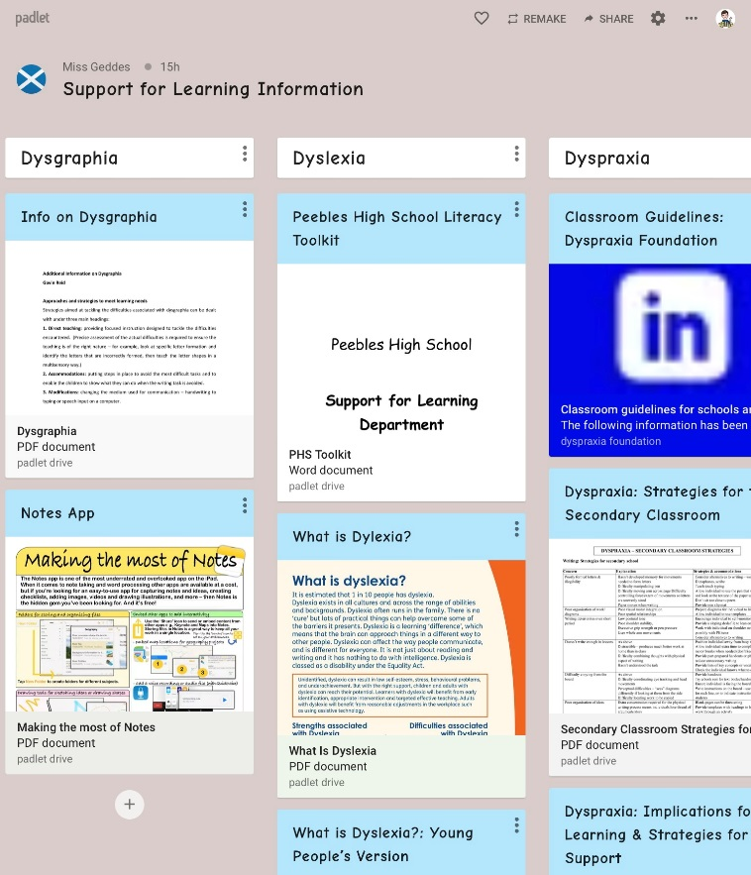
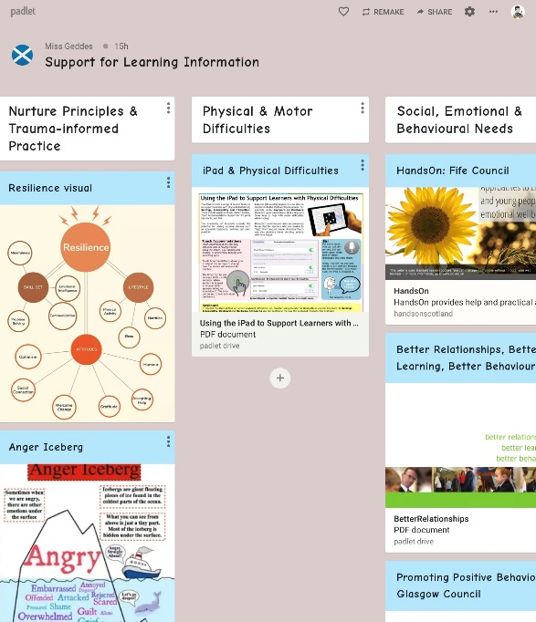
Staff CPD

Slide 5


Neurodiversity Group

Slide 6
AGENDA
Parent Council
  Welcome
  Support for Learning and Neurodiversity
  Pupil support
  Learning and Teaching update
  Open Forum S2
  Headteacher update & Q&A
We are waiting a few minutes to get a chance for everybody to join
Please put yourself on mute
If you struggle with quality at your end, consider turning your camera off
To ask a question / contribute, please
  Raise your hand - you'll be invited to unmute & speak
  Use the chat function
In rare cases, the 2 options above are not available, in which case please drop an email to phspc@outlook.com with your question

Slide 7

Sip priority 2 - Ensuring the highest quality of Personalised Support and inclusion for all learners

Slide 8
Presentation focus
The rationale behind the plan to re-structure Pupil Support and the journey so far
Becoming a more nurturing school

Slide 9
rationale
Support system no longer fit for purpose
Pastoral caseloads of 250+ mean that we are not meeting the needs of all young people (or the universal entitlement)
5 Pastoral PTs and 3 Houses
Not enough emphasis on tracking and monitoring and attainment
Pastoral and SfL need to be one support service
Need to come up with a system which supports all and create capacity in order to do so

Slide 10

SIP TASK 1 - Refine and agree a new structure for and approach to Pastoral Support with key stakeholders
Looking outward task – Lasswade HS, Larbert HS, Graeme HS, Waid Academy, West Calder HS
Role of Additional Needs Assistant
Pupil Support faculty
Increased staffing
Focus on attainment
Teachers lead interventions leading to qualifications, assistants lead interventions to improve relationships

Slide 11

Sip task 1 (continued) - Refine and agree a new structure for and approach to Pastoral Support with key stakeholders
PHS proposal – Plan A, Plan B and Plan C!
SBC Pupil Support Review
PHS Fire
Covid-19
SBC ASN Review

Slide 12

SIP task 3 - Pilot new approaches detailed in the vision this session
Appointment of three temporary Pupil Support Assistants (one per House) – January 2021
Attendance
Low level pastoral matters
Restorative approaches
‘Triage’ referrals to Pastoral PTs
Pilot to be reviewed in May

Slide 13

SIP tASK 5 - Fully engage with SBC’s Nurture programme for the session
“At the heart of nurture is a focus on wellbeing and relationships and a drive to support the growth and development of children and young people”
Applying Nurture as a Whole School Approach – Education Scotland

Slide 14

Nurture
SBC Priority 1 – All staff will become inclusive practitioners and will understand their personal responsibility to deliver inclusive and nurturing education across SBC
Nurturing Approaches – principles will be embedded in all schools and settings over the next 3 years
“In our sight, in our minds, in our actions and being heard.”

Slide 15


Why nurture?

Slide 16
What is a nurturing approach?
Learning is understood developmentally
All behaviour is communication
Six core principles
Positive relationships within school are central to learning and wellbeing
Based on attachment theory
Environment offers a Safe Base
Transitions are important in young people’s lives
Nurture is important for wellbeing
Language is a vital means of communication

Slide 17
Nurture roll out
Phase 1 – initial Nurture training, November inset
Phase 2 – completion of readiness questionnaire and self-evaluation toolkit
Phase 3 - all secondary schools will have an identified Nurture Base

Slide 18
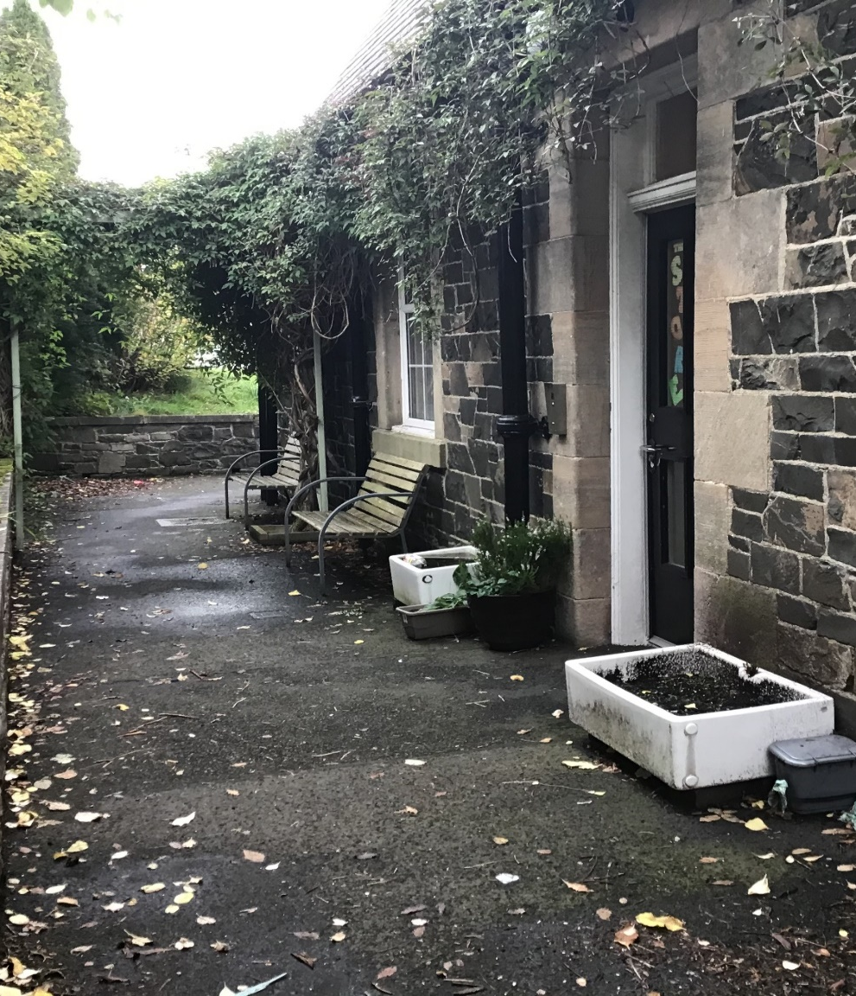
The store
The Store is a bridge between home and school offering
nurture based support for young people. It focuses on social and
emotional development and links with the wider school.

Slide 19
The store
Upstairs
Old janitor’s house
Upstairs
Downstairs
Outside
Safe Space, Quiet Room
Creative, Calm Room
Downstairs
Kitchen
Nurture Base
Outside – to be developed

Slide 20
Strengths of current provision
Communicating directly with families
Getting young people into school
Providing a Safe Base
Modelling Nurture
Re-engaging some young people with education
Restoring relationships
Building relationships with young people

Slide 21

Areas for
development
It isn’t Nurture in it’s broadest sense
Providing effective interventions
for all young people
Measuring impact
Improved links between the wider school and the Store
Meeting a little of many needs - fluttering between young people

Slide 22
What we are aiming to offer
Nurture
Group
Neuro- Diversity
Check In
8:30 –8:50
Young Person
Safe Space
Girls’
Group
Mini-Projects

Slide 23
Thank you for listening,
any questions?

Slide 24
AGENDA
Parent Council
  Welcome
  Support for Learning and Neurodiversity
  Pupil support
  Learning and Teaching update
  Open Forum S2
  Headteacher update & Q&A
We are waiting a few minutes to get a chance for everybody to join
Please put yourself on mute
If you struggle with quality at your end, consider turning your camera off
To ask a question / contribute, please
  Raise your hand - you'll be invited to unmute & speak
  Use the chat function
In rare cases, the 2 options above are not available, in which case please drop an email to phspc@outlook.com with your question

Slide 25

Parent Council Meeting
16th December 2020
Pupil & Parent Survey Results

Slide 26
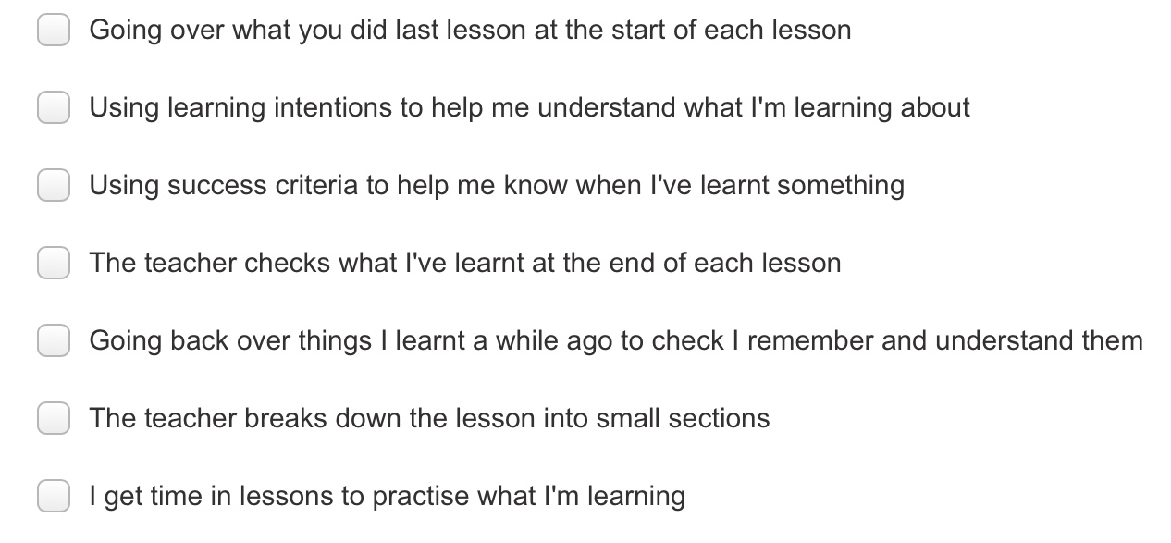
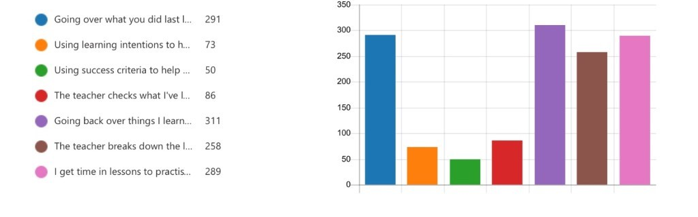
Q1 : Lesson Structure: Choose the 3 features of a lesson that you think help you learn best (457 respondents)

Slide 27
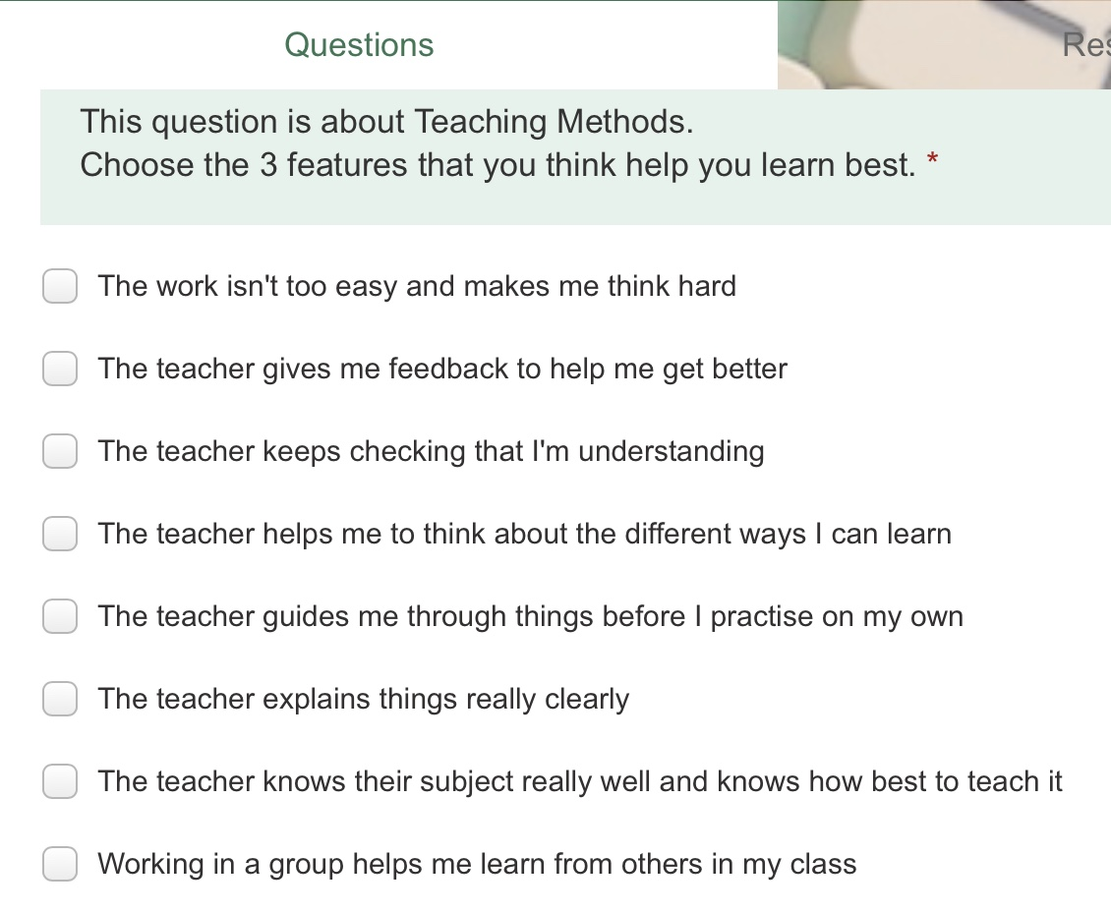
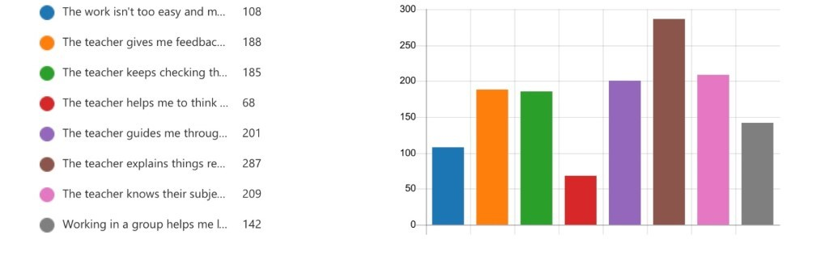
Q2. Teaching Methods: Choose the 3 things that help you learn best
(457 respondents)

Slide 28
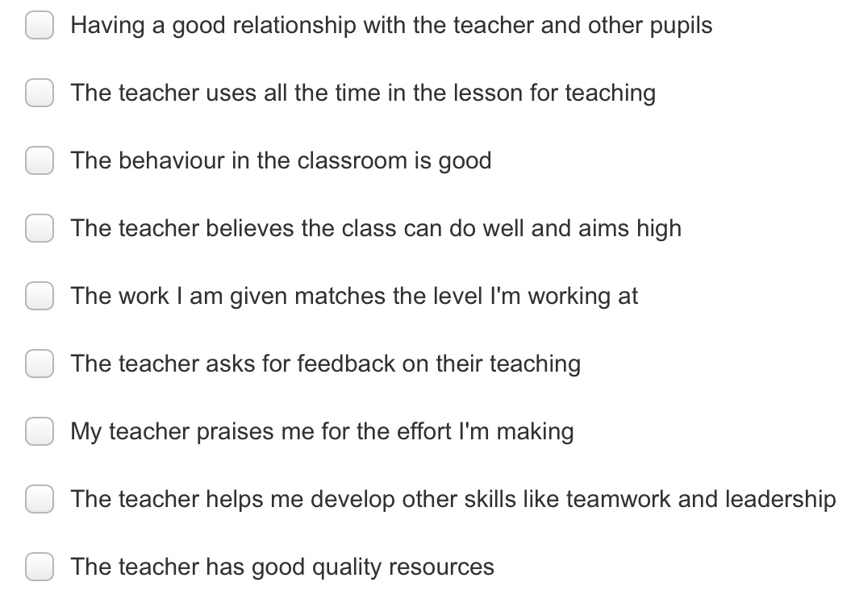
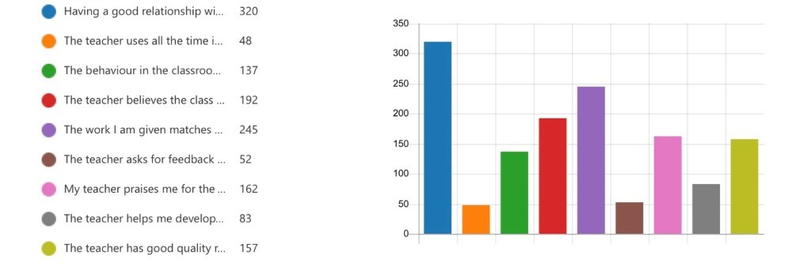
Q3. Learning Environment: Choose the 3 things that help you learn best
(457 respondents)

Slide 29
Q4. Please add any other things that teachers do to help you learn better
Check I understand
Give me help when I’m stuck
Give me work at the right level
Use varied tasks to learn
Let me work with friends
Kahoot
Make Lessons Interactive
Mark our work
Give me clear instructions

Slide 30
Parent Survey Results

Slide 31
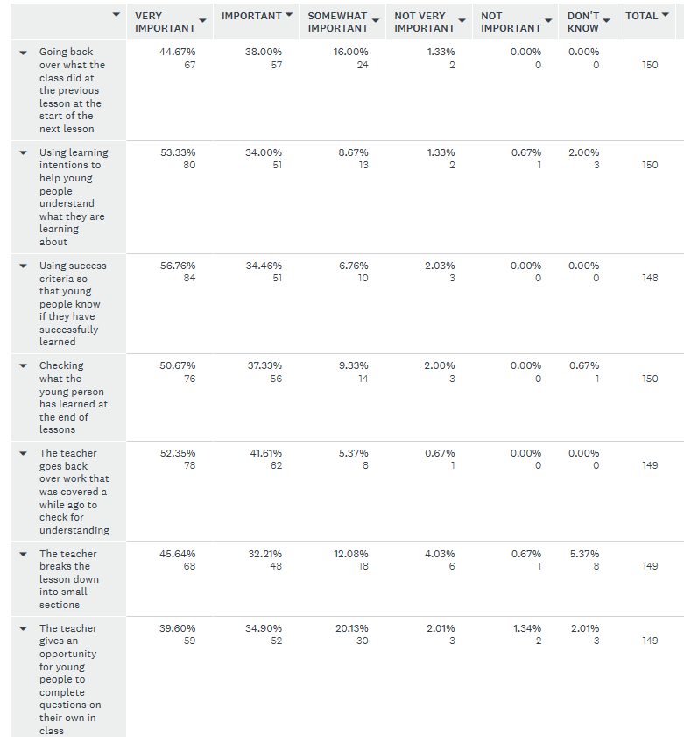
Q1

Slide 32

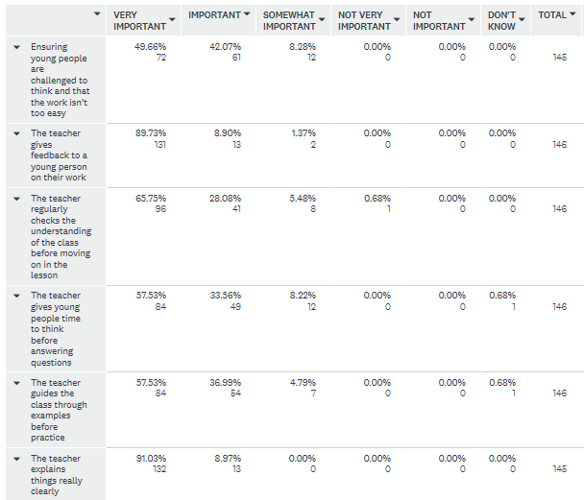
Q2

Slide 33
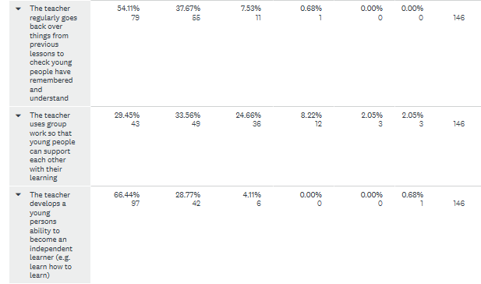
Q2

Slide 34

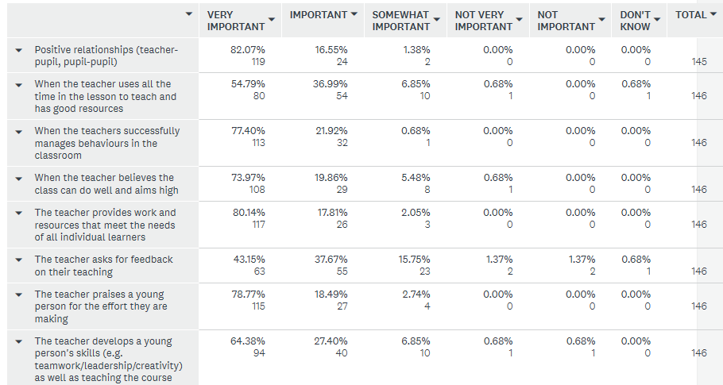
Q3

Slide 35
Q4
Feedback that I can help with
How to revise and learn at home
Check all young people understand in class
Meet learners needs
Consistency
High expectations
Passion for subject
Positive relationships / culture / climate / support
Too much doing questions/practice in class
Inspire and motivate

Slide 36
Next Steps
Lots to do but it is exciting work!!
We are meeting on a (framework) Friday
We are completing a review of the research and policy
We are making good progress with the framework – it will be learner friendly
End of January is our aim for a launch of the draft framework but there may be a staggered launch as it is becoming a very ambitious document

Slide 37
AGENDA
Parent Council
  Welcome
  Support for Learning and Neurodiversity
  Pupil support
  Learning and Teaching update
  Open Forum S2
  Headteacher update & Q&A
We are waiting a few minutes to get a chance for everybody to join
Please put yourself on mute
If you struggle with quality at your end, consider turning your camera off
To ask a question / contribute, please
  Raise your hand - you'll be invited to unmute & speak
  Use the chat function
In rare cases, the 2 options above are not available, in which case please drop an email to phspc@outlook.com with your question

