Slide 1

PROCESS FOR SQA ESTIMATES
2019-2020

Slide 2
SQA Process
4 Stages for 2019-20
  Estimates
  Awarding
  Results and Certification
  Appeals

Slide 3
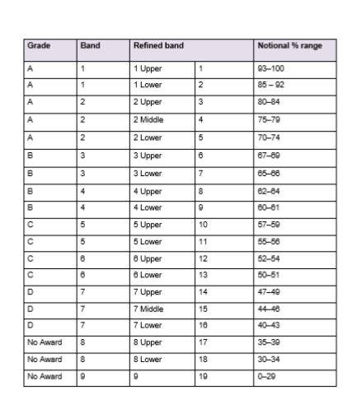
Estimates
Stage 3
Rank students in order within each refined band.
Stage 1
Assign an overall
Band (Usual Practice)
Stage 2
Assign a refined
Band

Slide 4
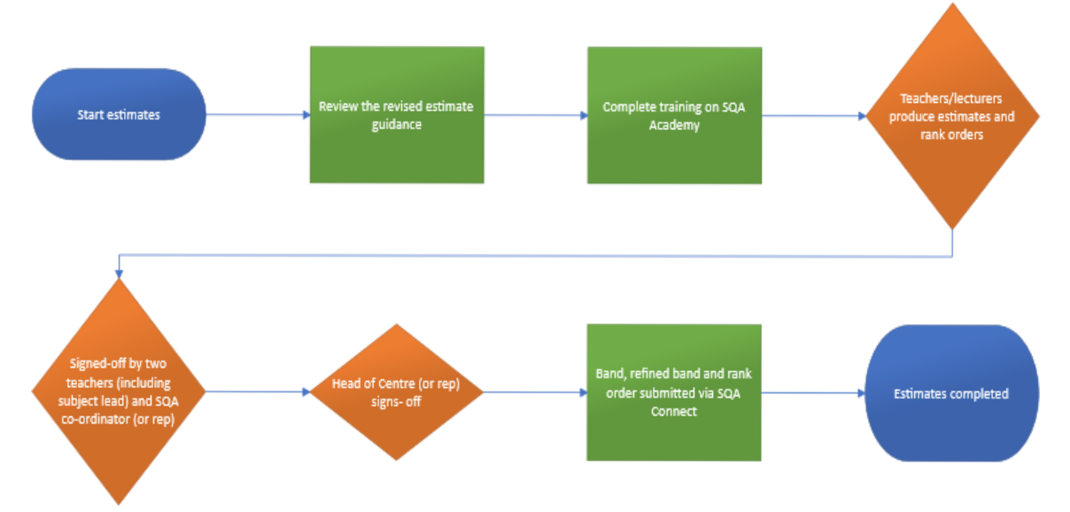

Slide 5
Departmental Moderation
Parameters set by PT
Data sources agreed and weighted. Contingencies made where necessary.
Internal moderation (Cross marking, PT QA, Whole Team marking).
Estimates produced and tested against comparable evidence.
Refine the process
Anomalies identified and investigated.
Refined bands – Teams of Staff met to consider rankings based upon the evidence.

Slide 6
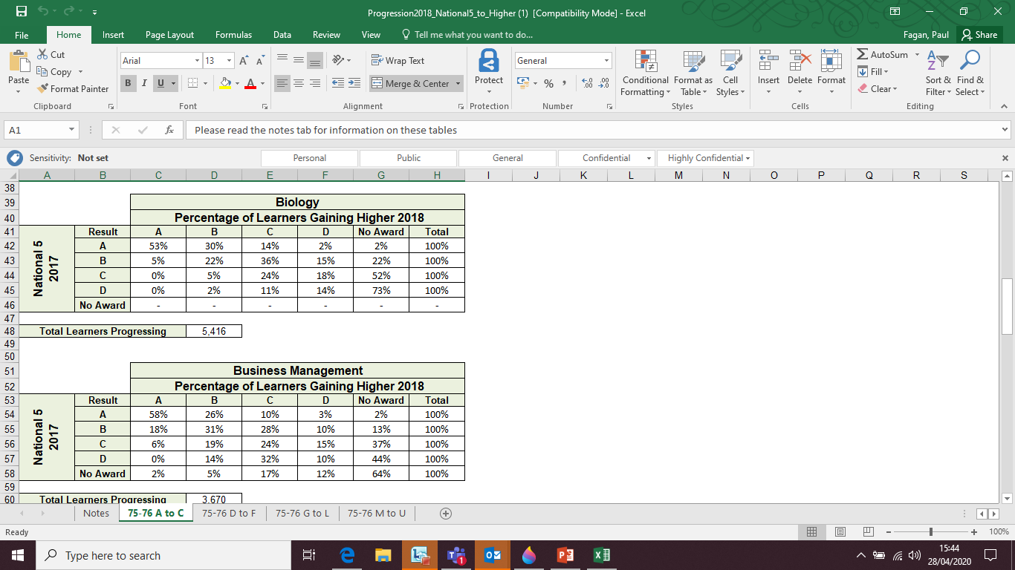

Slide 7
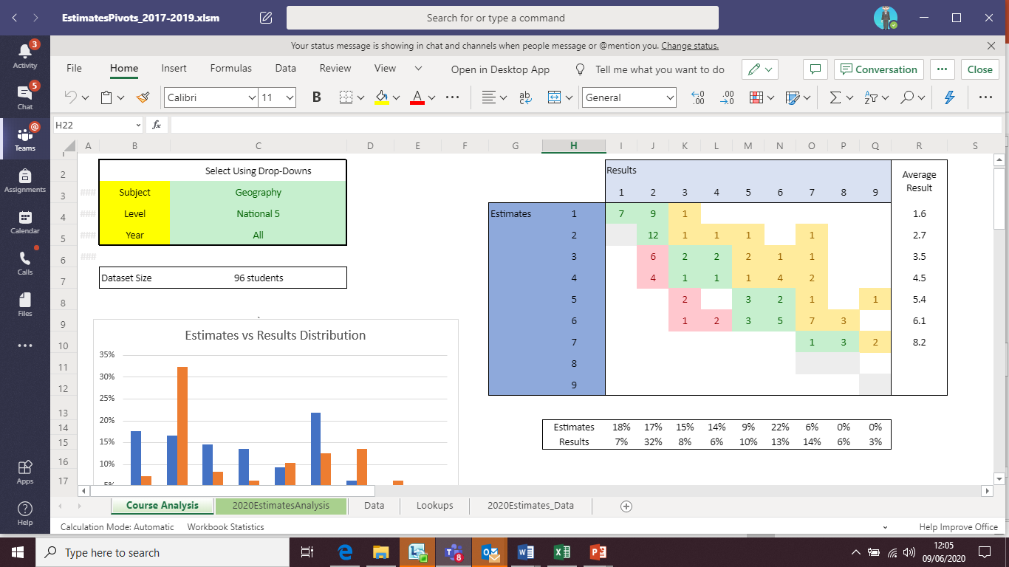

Slide 8
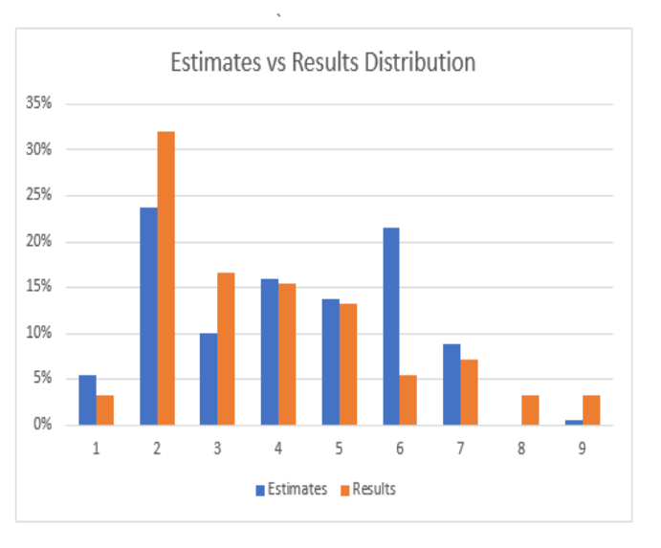

Slide 9
SLT Moderation
SLT Led Professional Learning and Set Parameters for Estimate Process
SLT analysis of May 2020 estimates by subject vs attainment trends. Outstanding anomalies identified and departments affected asked to either explain or refine estimates.
SLT analysis of May 2020 estimates vs attainment trends overall evaluated. Data compared to 5 and 3 year trends including progression data.
SLT analysis of anomalies return. Further conversations with ELT.
Checking of accuracy estimate entries by Admin & ELT.

Slide 10
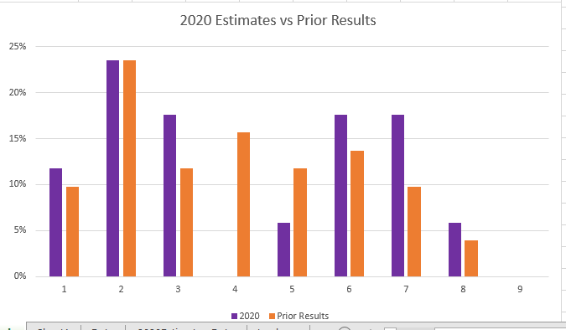
Next Steps – Quality Assurance

